Slide 1
Dramatic Slide Examples
Todd King

Slide 2
Overview
These slides are designed to have a narrator placed on the left side. For some presentation styles, instead of a narrator, text can be placed on the left.
Each slide has instructions on the left on how to create a similar slide or modify the existing slide. Naturally, this text should be removed when used.

Slide 3
What you will learn
A table of contents, topics or objectives.
How its done
Each topic is a rounded end rectangle with text. The animation is set to “Fly-in” from the right.
First topic
Second topic
Third topic
Forth topic

Slide 4

Typing
Enter text in the screen and it will appear as though it was typed when the slide appears.
How its done
There is a text box overlaying on the laptop graphic. The timing for the animation for the text box has the “effect” for “Animate text” set to “By letter” with a delay of 0.05.
There are two kinds of people, those that know how to …

Slide 5

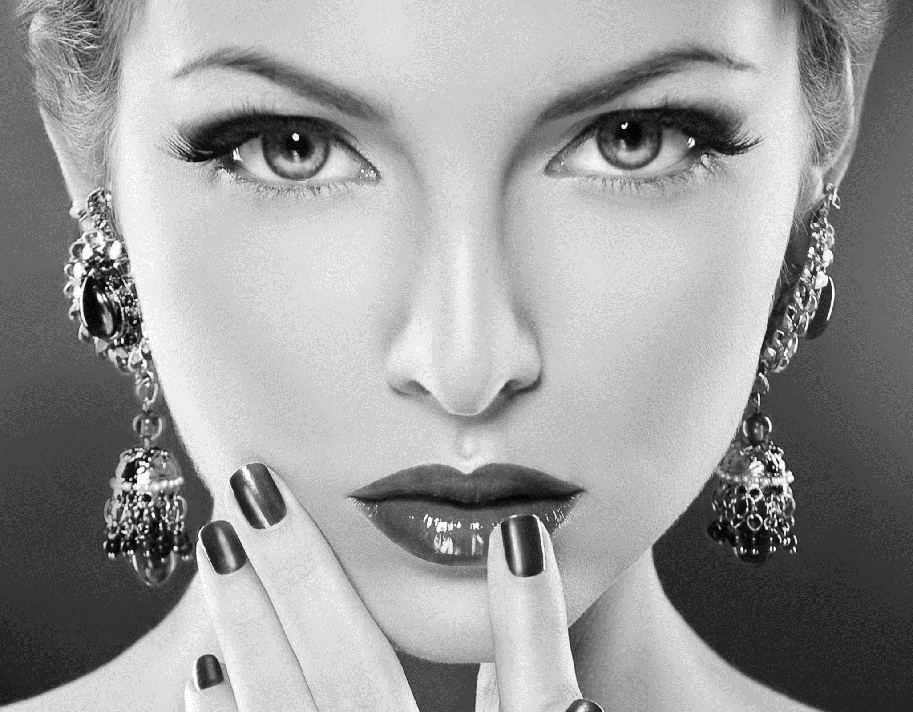
Zoom
Zoom affect
How its done
Its three separate images that are overlaid and aligned.
The first image is full color.
Create copy and change color to b/w
Create copy, enlarge and crop, then a second crop using “crop to shape”
Animate b/w and cropped image to appear together.
Tutorial: https://www.youtube.com/watch?v=kVFnELF8Jmo

Slide 6


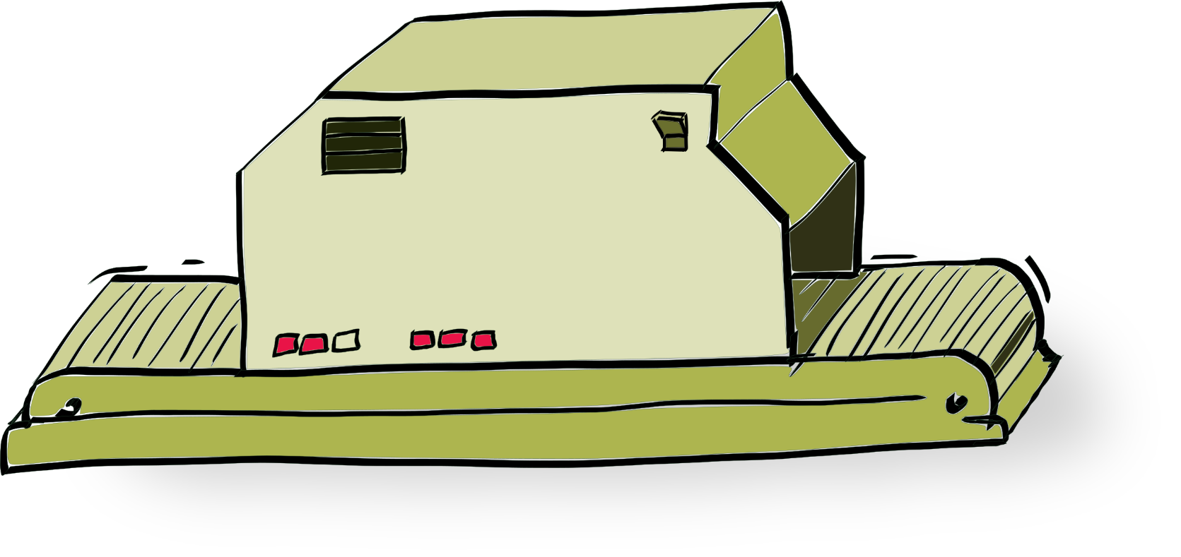



Animations
How its done
Add images
Set both entrance and motion paths for the moving pieces.
#set($greeting = “Hello”)
#set($object = “World”)
<salutation> $greeting $object!
</salutation>
<salutation> Hello World!
</salutation>
01000011 01000100 01000110
CDF
docgen
VM
LBL

Slide 7
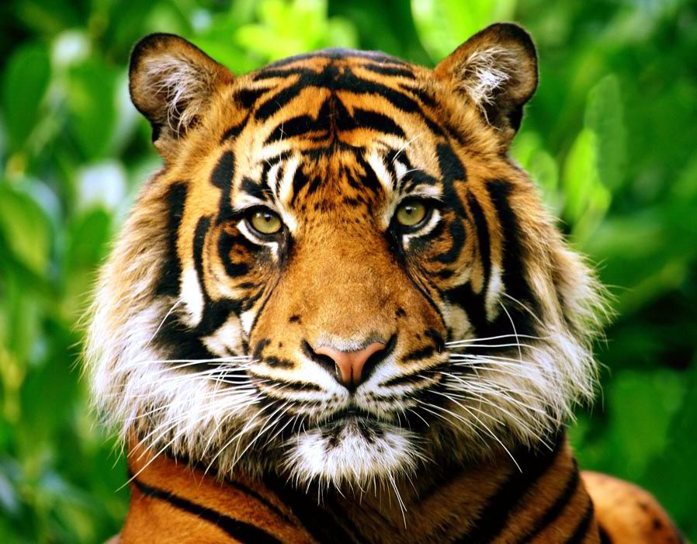
Reveal an image
How its done
Place image.
Create curtain with openings using drawing tools. Multi-select and merge shapes as “combined”.
Create shapes to cover openings.
Set animation on each shape to reveal curtain.
Make frame disappear
One
Two
Three
Four
Five

Slide 8


Scrolling background
How its done
Place a wide image as background.
Cover image with a wide rectangle the width of the slide. Create an opening in the rectangle by adding another shape, then with multi-select and merge shapes as “combined”.
Set animation of the wide image to a straight motion path. Adjust end points to scroll full image.
Place image of main subject in opening.

Slide 9

Handwriting
Handwriting
How its done
Use the font “Segoe Print”
Place pen image with pen at starting point.
Set animation as a custom motion path and trace the letters with mouse.
Set timing duration to maximum (5 seconds).
Set timing between letters to get pen and text appearance to look right.
This is handwritten text.

Slide 10
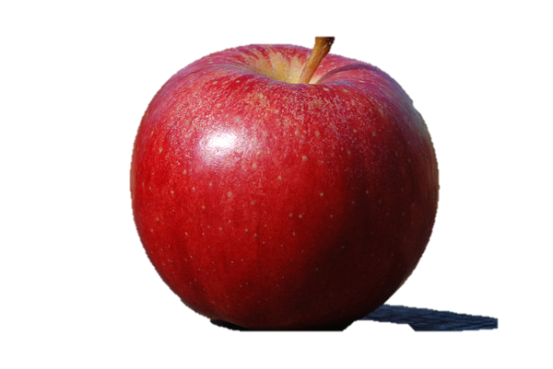
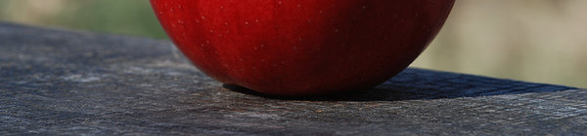
3D Pop out
How its done
Pick a picture with the main object fully in frame and good contrast.
Make a copy of the image.
In one image crop with trapezoid to include just the “in frame” part of the object.
In the other image remove background.
Place over the cropped image.
Tutorial: https://www.youtube.com/watch?v=Y_FidKWc_Lg

Slide 11
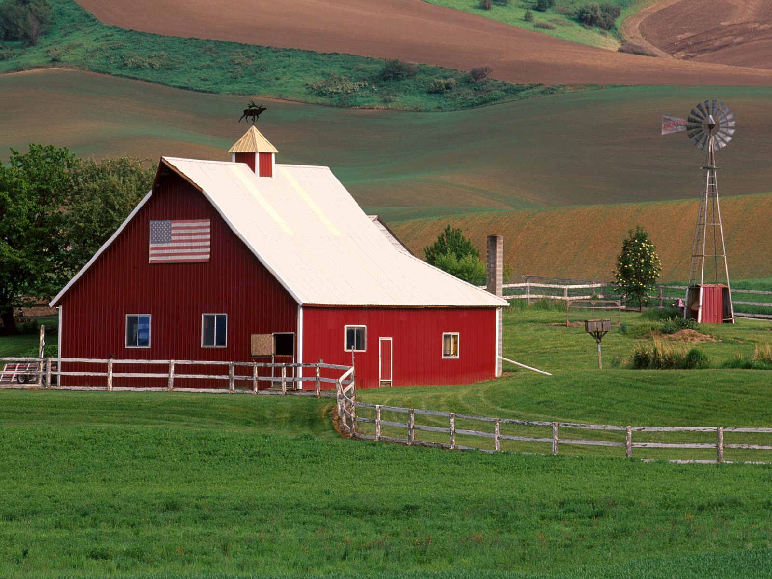
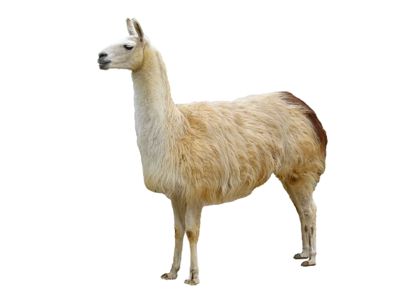


Pop in
How its done
Choose a background image.
Duplicate and crop top image to create area to pop in other images
Add other images and animate.

